Slide 1


Senior Design Project
Meme Teme
March 14, 2019
Siddhi Panchal - Developer
Emma Pedersen - Developer
Zachary Plante - Developer
Mia Altieri - Product Owner and Developer
Jonathan Chong - Scrum Master and Developer

Slide 2
The Problem
Memes are funny, BUT not all memes are funny!
Each person has their own refined Meme tastes and preferences.
No adequate social media mobile application based solely around Memes.

Slide 3
Temporary Solution
Currently people will find their Memes through reddit, facebook, twitter, instagram, etc.
Sometimes these applications have irrelevant content such as family photos, status updates, or posts about feelings.
When looking at Memes a user often sees memes that they do not find funny or fully enjoy

Slide 4
Our Solution
We want to solve this problem by creating:
A mobile application that is purely Meme based
A Meme based application that can learn from a user’s Meme tastes and recommend quality Memes to them.

Slide 5
Release 1 Goals
Release app with core functionality on the App Store
Core functionality includes social functions and general usability
Creating an account with email
Following and searching users
Reacting to memes
Viewing memes in a feed-style screen
Viewing the memes you have positively reacted to
Notes:
Emma

Slide 6
Release 2 Goals
Use machine learning to recommend memes
Based on the memes you and people you follow react to
Display these recommended memes into a curated feed
Continue to iterate on core functionality
Upload own memes
Gather user data
Refine usability and aesthetics
Release on Google Play Store
Notes:
Emma

Slide 7
Development Requirements
Hardware
Macs - for Xcode
Software
Xcode - for simulator
npm - for installing and running React Native
Notes:
Zac

Slide 8
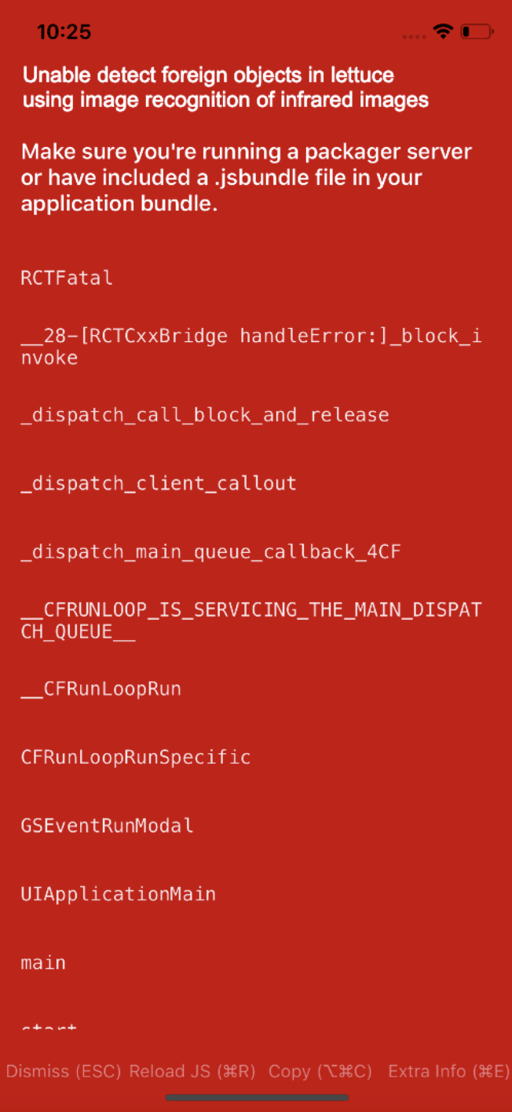
Challenges
Debugging with React Native
Not getting correct functionality from Firebase and learning the technology.
Learning to work with React Native framework
Getting distracted by memes
Notes:
Zac

Slide 9
Our Approach
The application is based several feeds where the user can:
View their previous likes
View the likes of their friends
View relevant and new memes from reddit
Facilitating user interactions
Searching and visiting other user’s profile
Following users so they show up in your friend feed
Notes:
zac

Slide 10
Demo
https://youtu.be/8L6TP4dj5t8
Notes:
jon

Slide 11
Solution Components:
Our major components in our application are:
A variety of feeds
User profiles to keep track of a users reacts
Searching for users
A web scraper to find memes
Notes:
jon

Slide 12
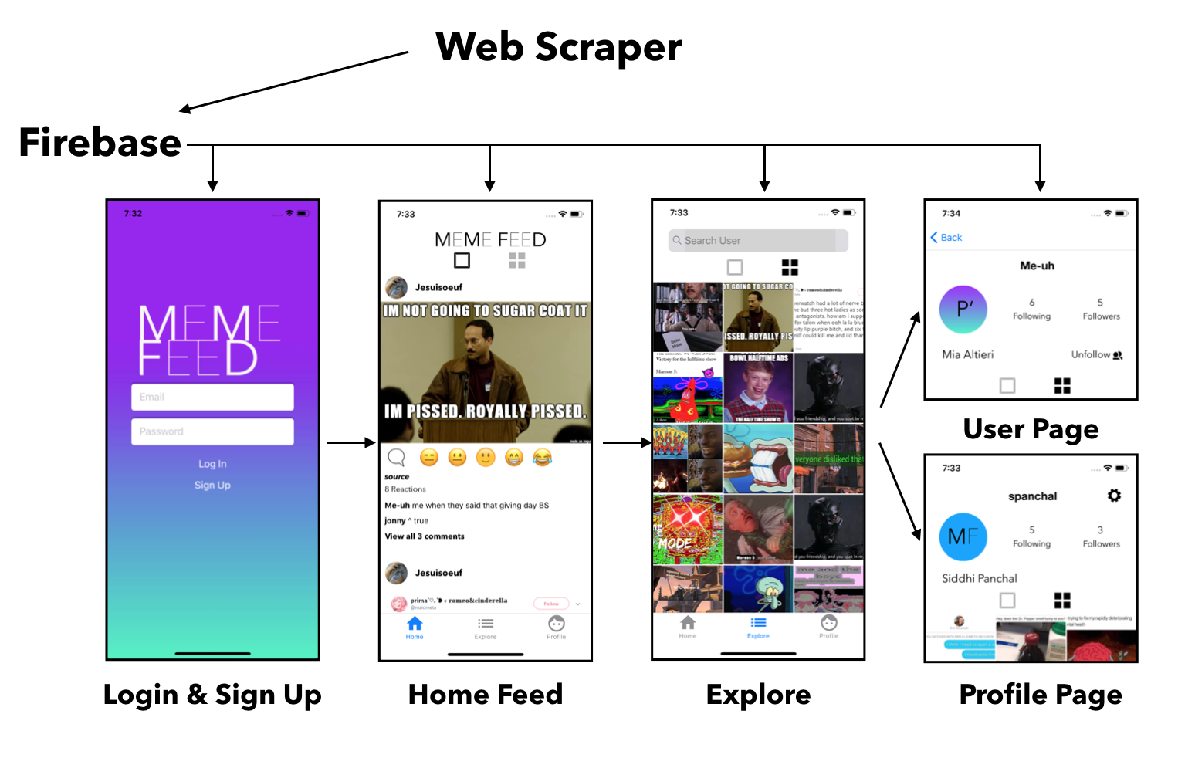
Notes:
jon

Slide 13
Technology Stack
Our application relies on Firebase, React-Native and NPM,
Firebase
Used to store the data for the application
React-Native
Front-end Framework
npm
Package Management
Xcode
Testing
Notes:
Siddhi

Slide 14
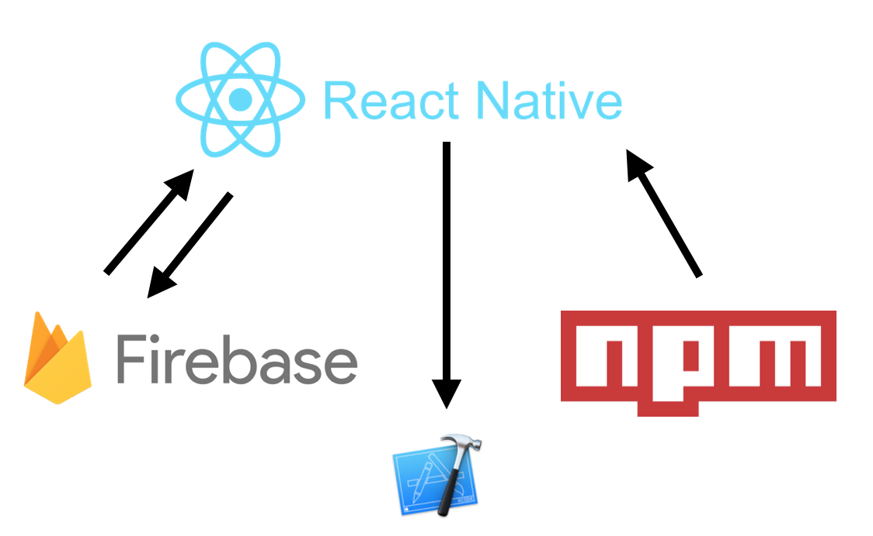
Technology Flow
Framework and Frontend
Increase functionality
Pulling user data
Storing data into database like reacts and users
Running app on Xcode simulator
Database, Authentication, and Backend Functionality
Package management system
Xcode
Notes:
Siddhi

Slide 15
Results & Achievements
Created a clean and functional mobile application began release process
Basic User Functionality
Creating an account with email
Reacting to memes
Viewing memes in a feed-style screen
Viewing the memes a user positively reacted to
User Interaction
Following and searching users
Viewing the content of other users
Detect foreign objects in lettuce using image recognition of infrared images
Notes:
Siddhi

Slide 16
Release 2 Goals
Objectives for Release 2
Creating a machine learning algorithm to suggest memes based on a follower’s likes and dislikes.
Allow users to be able to upload memes of their own.
Final Project: Fully functioning app with machine learning capabilities, extremely user friendly
How will we know the project was a success?
When we get good reviews on the App Store
When we get a bajillion downloads on the App Store
Notes:
Siddhi

Slide 17
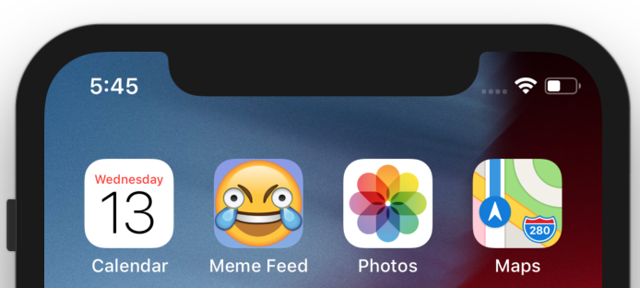
Questions
-&-
Comments
Look out for Meme Feed coming to the App Store Spring 2019

